Slide 1


Learning
Information Technology
Presented by TMC

Slide 2
Agenda
What
How long
Why
Schedule
Teaching Method
Cost
Job
Who
Q & A

Slide 3



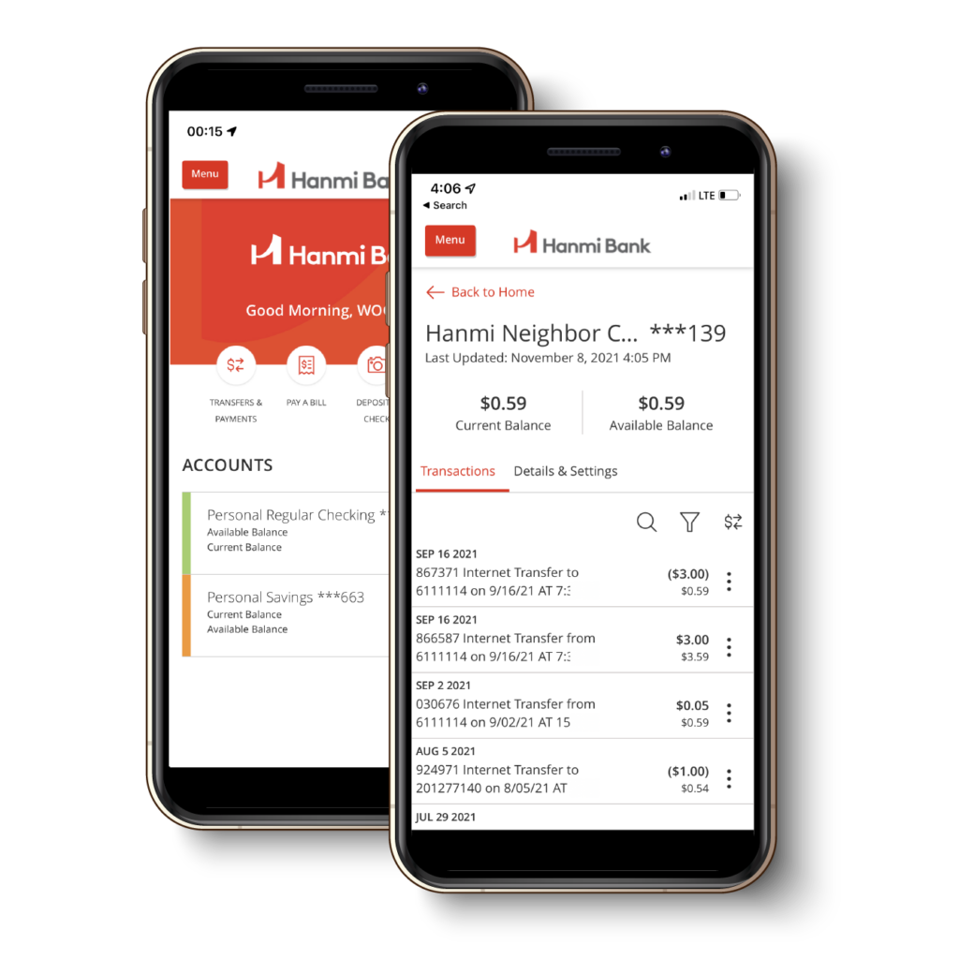

What is Information Technology
Meaningful facts about something or someone

Slide 4


IT Development Process
Business Analyst
Developer
Quality Assurance
Scrum Master
Project Manager

Slide 5
Scope of this Course
IT Foundation
Mid Level Programming
Advanced
Programming
Software
Developer
QA
Manual
QA
Automation

Slide 6
Course Duration
IT Foundation
2 months
Mid Level Programming
2 months
Advanced
Programming
3 months
QA
Manual
2 months
QA
Automation
2 months
Software
Developer

Slide 7
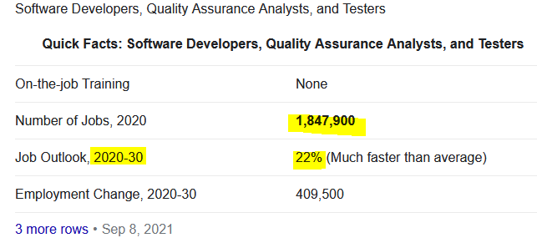
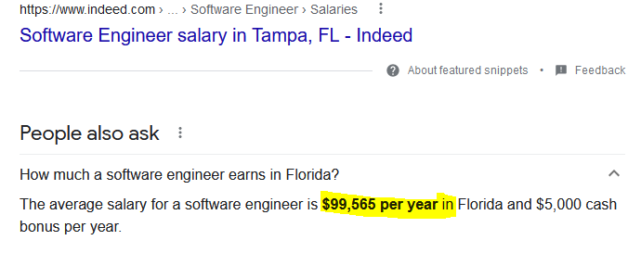
Why

Slide 8
Schedule?
Starting first week of February 2022
2 sessions per week
  1h 30m session
  Monday and Thursday
  8:00PM to 9:30PM
Additional session if needed
Sessions are recorded

Slide 9
Teaching Methos?
In session topic intro / Guide
Online video tutorial for in depth learning
Hands on assignments
Ad hoc labs to go over the assignments

Slide 10
Cost?
Free
Expensive
  Time
  Computer (windows based) – 16GB ram
  Online Course Fee
  Certification Fee

Slide 11
Job
Education
Certification
Relevant
Experience
Successful
Interview

Slide 12
Is it for me?
Background
Not for everyone
Not a hobby – real need
Inner Drive – self motivated

Slide 13
Thank you!
Questions & Answers

